Slide 1
Suitable Site Selection For Small Dam Using GIS Techniques
Raheel Abbas
GIS Analyst

Slide 2
INTRODUCTION
Water is one of the resources that cannot be generated but only be preserved. In future water scarcity will be one of the biggest challenges in the World. The only way to conserve this resource is through construction of dams/reservoirs.

Slide 3
Why khuzdar?
Khuzdar is at the apex of a narrow valley at an elevation of 1,237 meters (4,058 ft.).
Khuzdar receive highest amount of rainfall in Baluchistan.
Availability of Natural Drainage Pattern that support water accumulation in low-Lands.
High water threshold because population of Khuzdar District was estimated to be over 525,000 in 2005.
Towns and cities in Baluchistan are not as big as compared to other provinces generally due to scarcity of water.

Slide 4
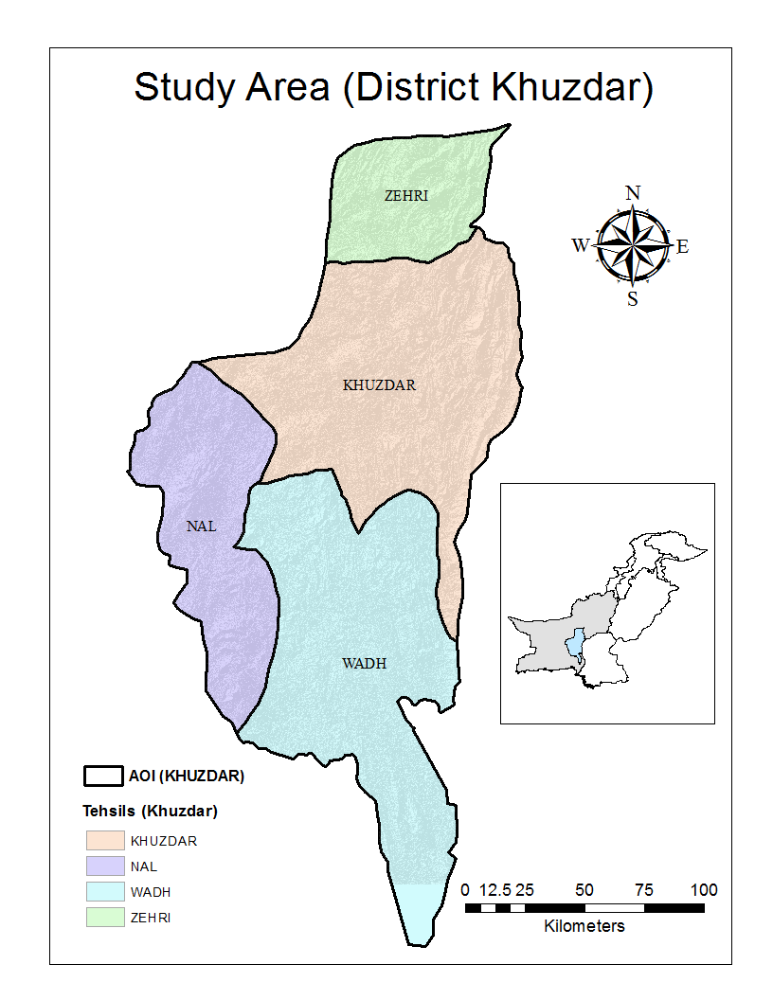
STUDY AREA
The district is subdivided
into four tehsils :
1.Khuzdar
2.Zehri
3.Naal
4.Wadhi

Slide 5
OBJECTIVES
DAM / RESERVOIR SITES SELECTION USING REMOTE SENSING & GIS TECHNIQUES.
Suitability Index for location of small dams and reservoirs.
Calculate topography wetness index of the district Khuzdar.

Slide 6
METHODOLOGY
The dam and reservoir site must:
1 Not be located in or near settlement areas (Safety)
2 Be on water accumulated areas. (Water management)
3 Be on a gentle slope. (Environmental/safety)
4 Have a sufficient volume of rainfall. (Consumption/economic)

Slide 7
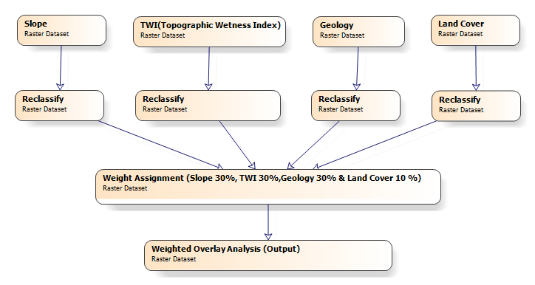
WEIGHTED OVERLAY ANALYSIS

Slide 8
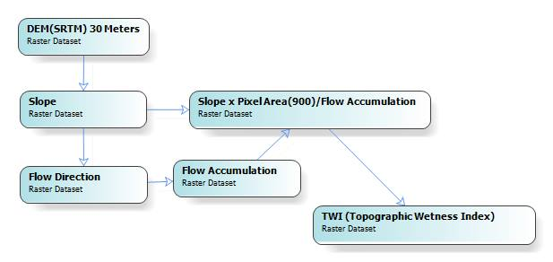
TOPOGRAPHIC WETNESS INDEX

Slide 9
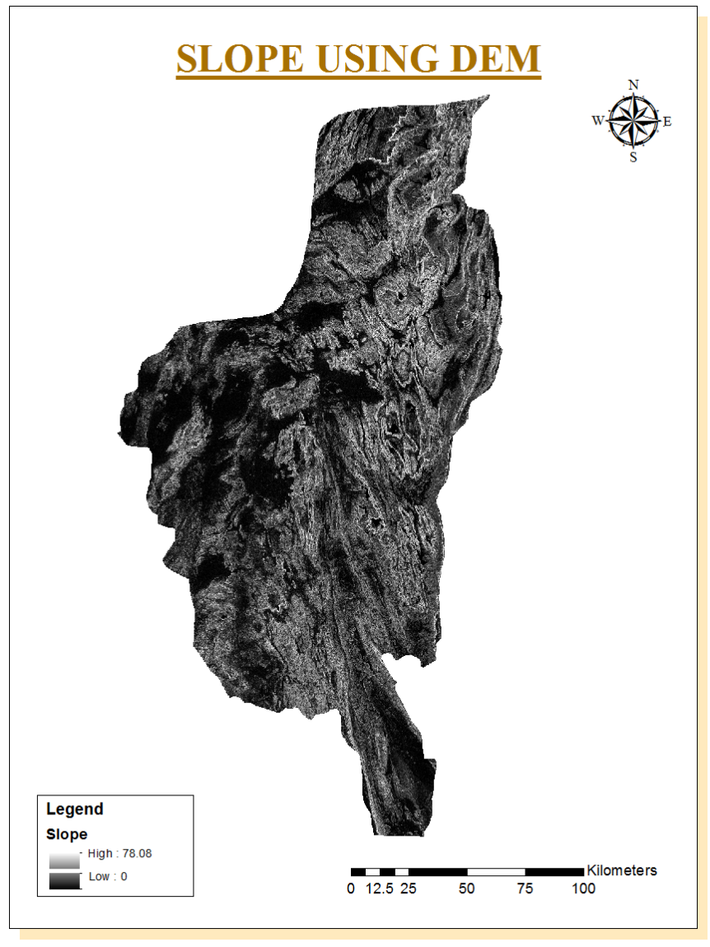
Slope, by using SRTM (DEM)
Slopes are derived from Digital Elevation Model (SRTM) 30-Meters.
Steeper slopes are more preferable as compared to gentle slopes because……
Flow directions are obtained from slope to evaluate drainage pattern of the area.
Flow accumulation areas are identified using flow direction/drainage.

Slide 10
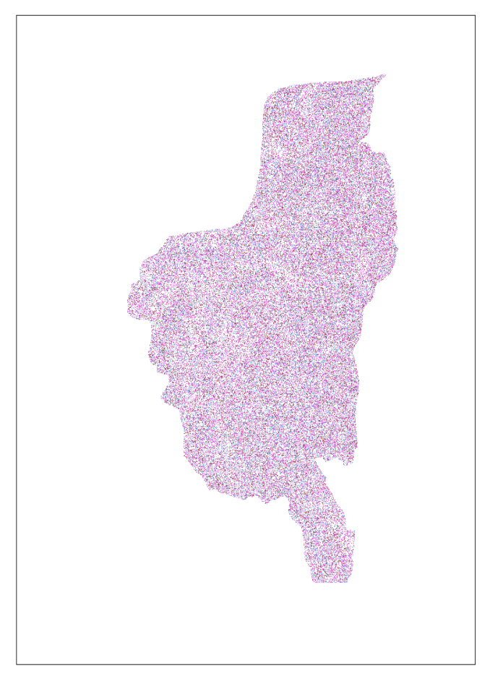
TWI(TOPOGRAPHIC WETNESS INDEX)
The Topographic wetness index (TWI), also known as the compound topographic index (CTI), is a steady state wetness index. It is commonly used to quantify topographic control on hydrological processes.
TWI=Slope*Pixel Area/Flow Accumulation.

Slide 11
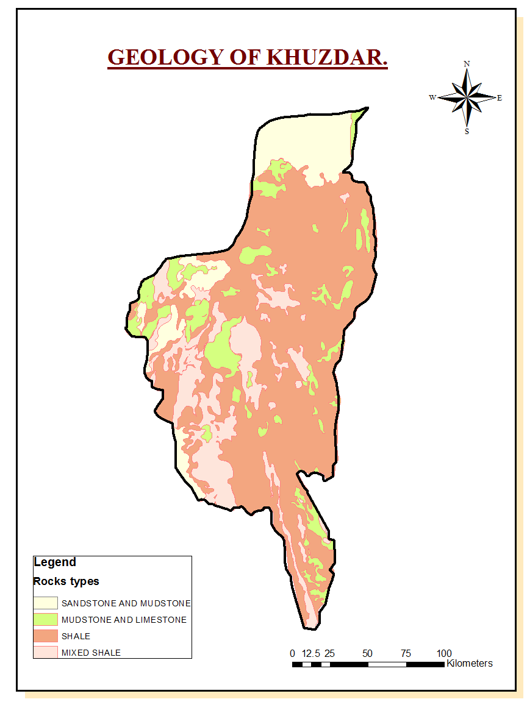
GEOLOGY OF KHUZDAR
Geology of Khuzdar dominated by Shale and rarely mix shale, mudstone, sandstone. Shale consist of special types of soil like clay that is due to its porosity reserves dams and reserviors.

Slide 12
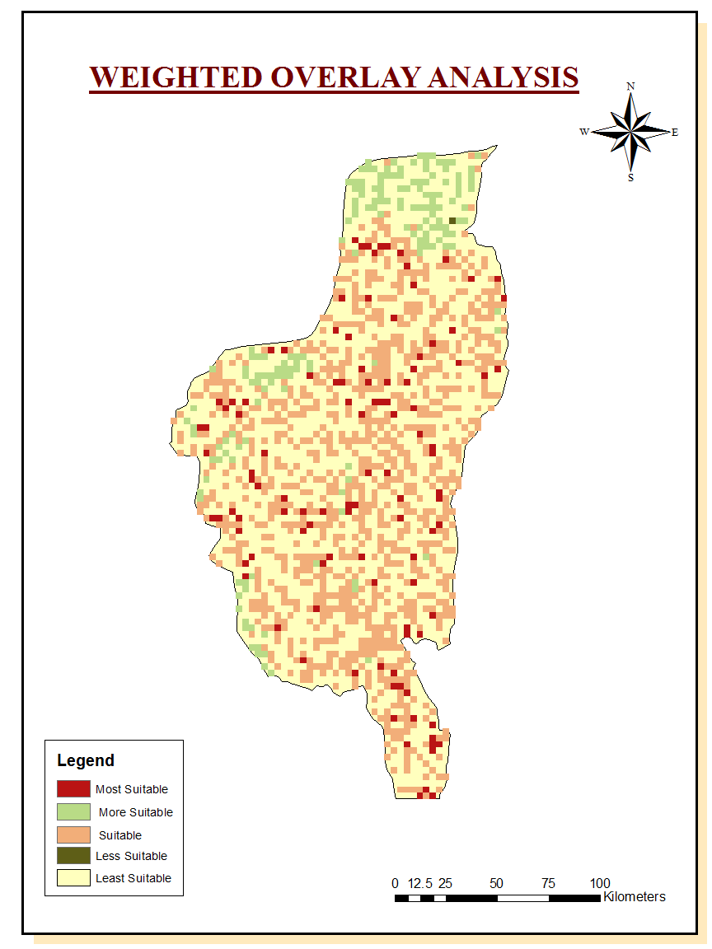
WEIGHTED OVERLAY ANALYSIS
The Weighted Overlay scales the input data on a defined scale (the default being 1 to 9), weights the input raster's, and adds them together. The more favorable locations for each input criterion will be reclassed to the higher values such as 9. In the Weighted Overlay tool, the weights assigned to the input rasters must equal 100 percent.

Slide 13
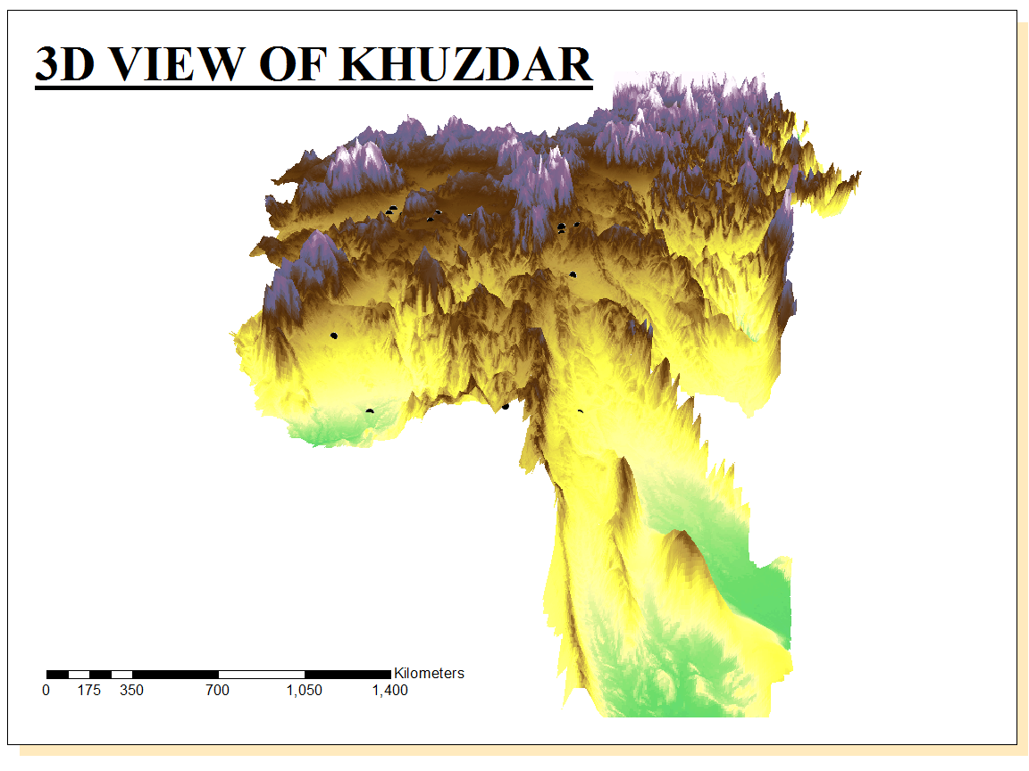
3D Representation
Khuzdar is at the apex of a narrow valley at an elevation of 1,237 meters (4,058 ft.).

Slide 14
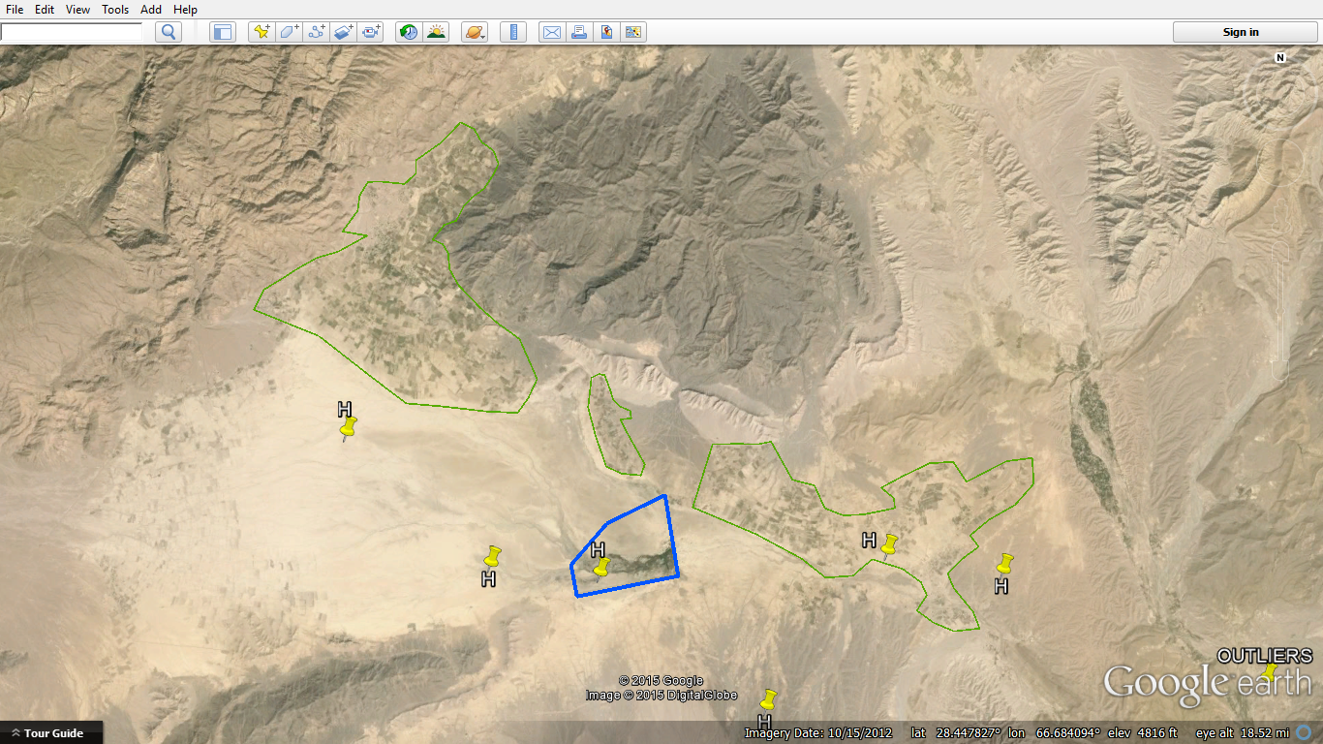

Slide 15
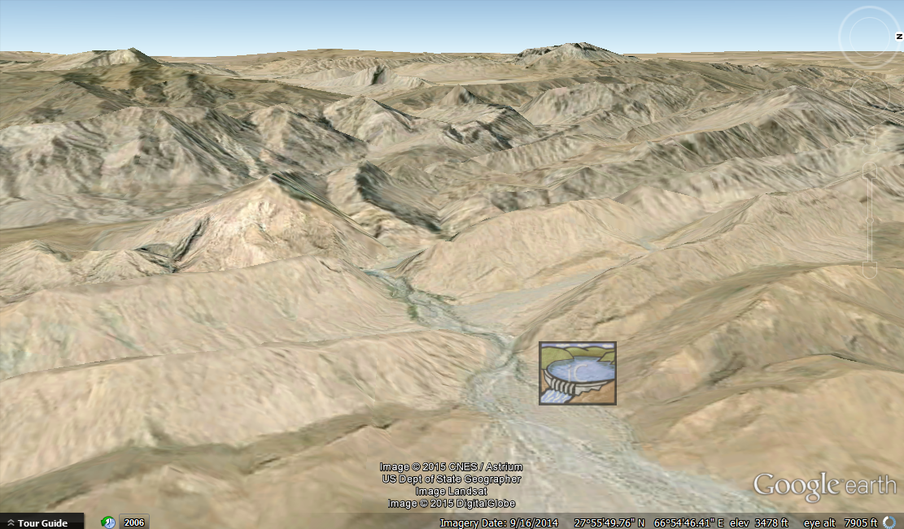

Slide 16
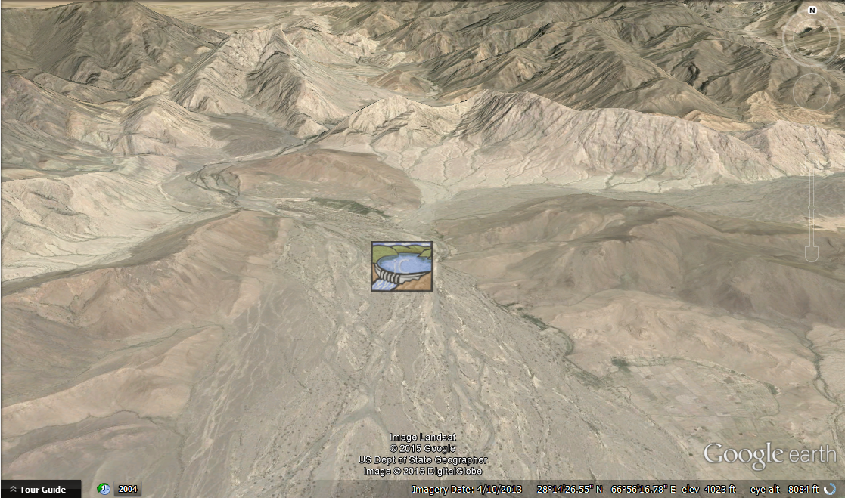

Slide 17
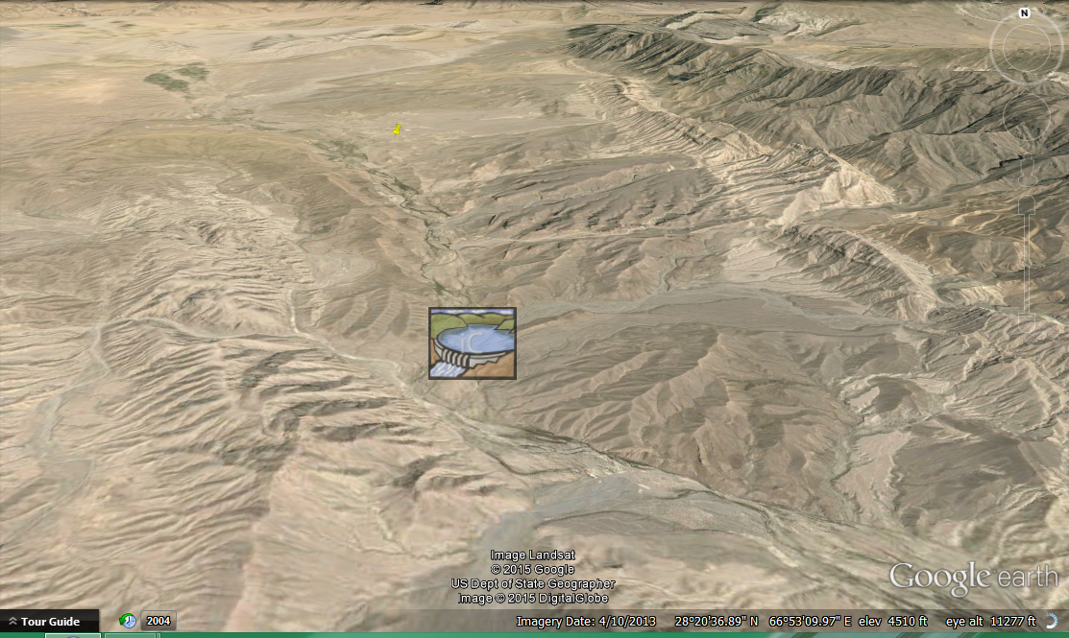

Slide 18
CONCLUSION
The resultant of weighted overlay analysis shows us that all the most suitable site were valleys with gentle slopes having lithology dominant with shale, mix shale, mudstone, sandstone.
Results are verified by presence of pre-existing small dams near selected sites.
Presence of Seasonal rivers along preferred dam/suitable sites assures accumulation/availability of rain water.

Slide 19
REFERNCES
Research Articles
DAM / RESERVOIR SITES SELECTION USING REMOTE SENSING & GIS TECHNIQUES by Muhammad Ateeq Qureshi.
(RS&GIS Application Division , Pakistan Space and Upper Atmosphere Research Commission (SUPARCO).
A SPATIAL MULTI-CRITERIA ANALYSIS APPROACH FOR LOCATING SUITABLE SITES FOR CONSTRUCTION OF SUBSURFACE DAMS IN NORTHERN PAKISTAN.
Imran Ali Jamali & Ulla Mörtberg & Bo Olofsson & Muhammad Shafique.

Slide 20
Thanks for Patience

